Slide 1



Project: Magician
Isolator Prototype with Experimental Results

Slide 2

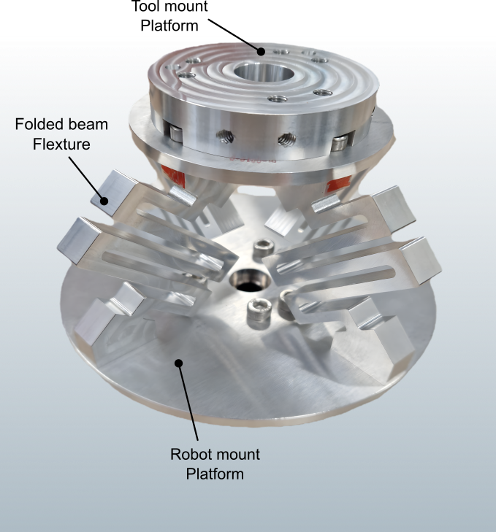
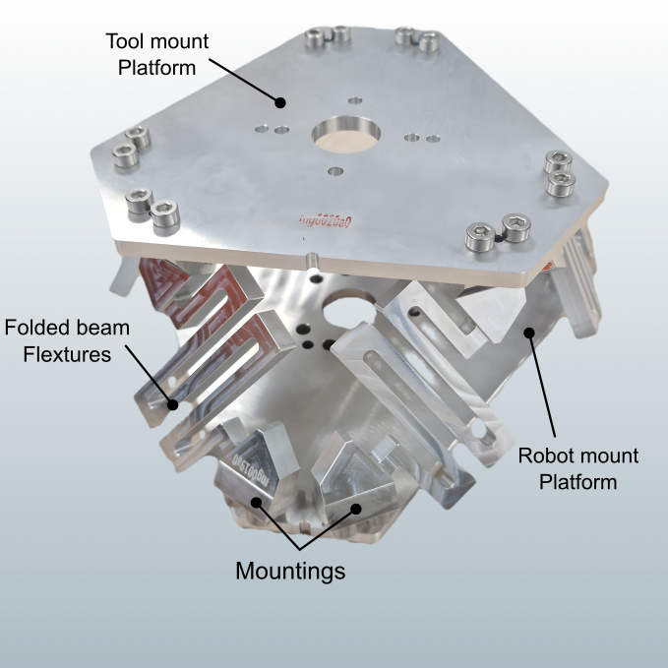
Machined Prototype Isolator platform
Conventional Isolator Platform
Stewart based Isolator Platform

Slide 3
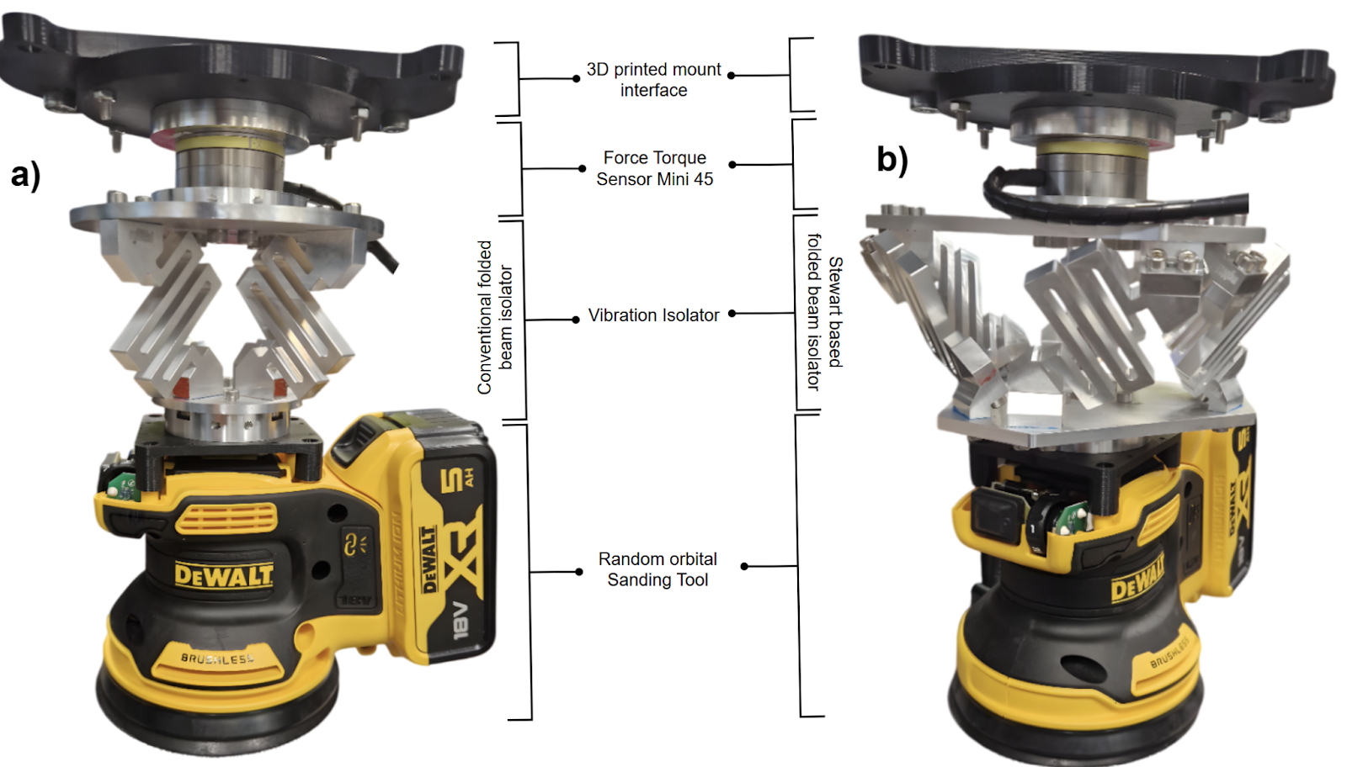
Assembled Prototype End Effectors
a) Tool end effector interface with conventional isolator
b) Tool end effector interface with Stewart based isolator platform

Slide 4
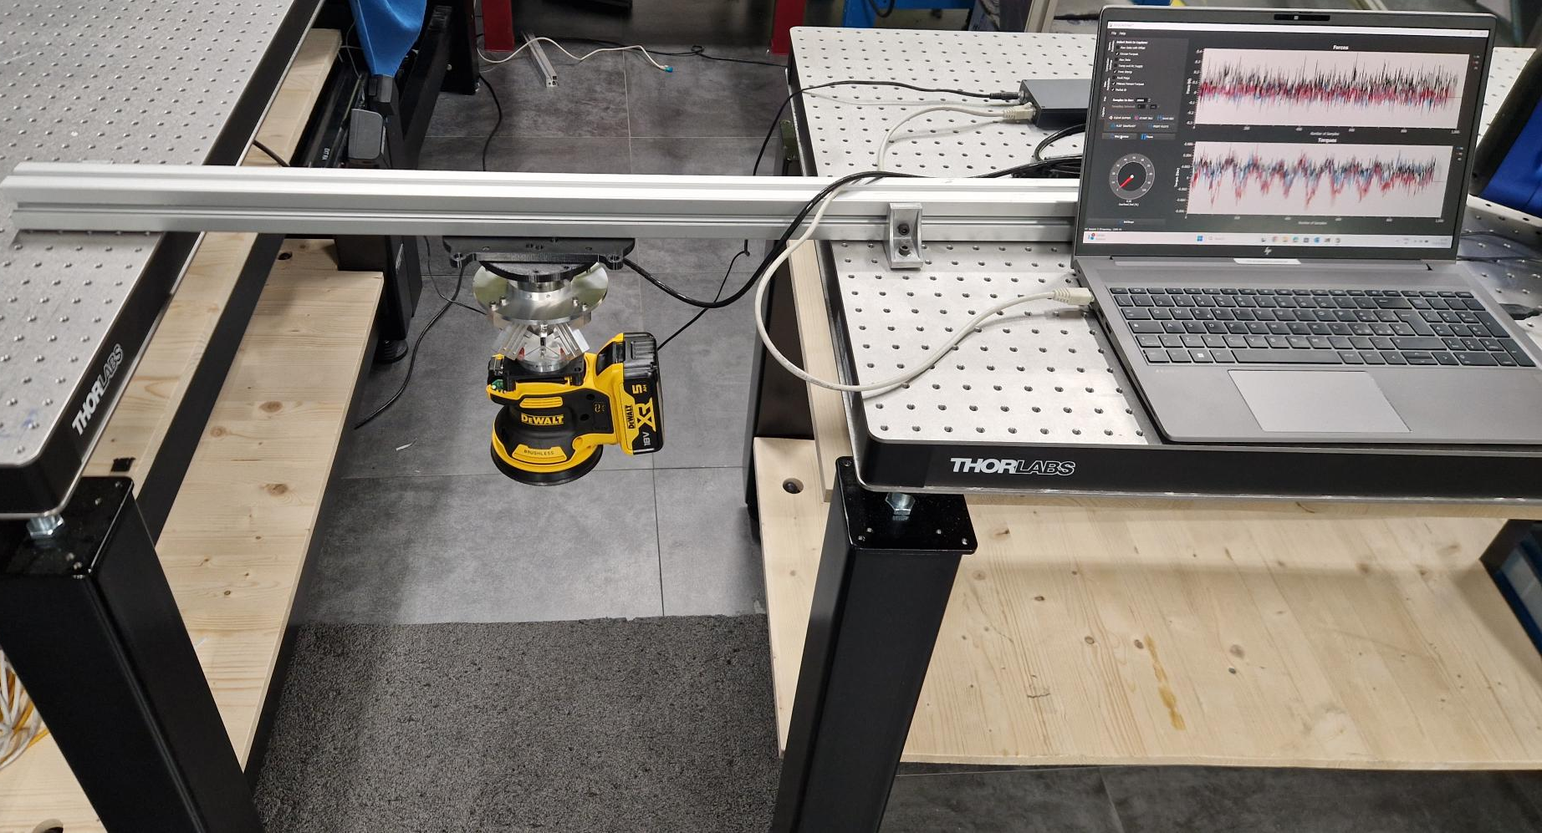
Experimental Setup
Free - Fixed zero degree orientation Experiment
Initial testing to analyse the performance of the isolator platform
Each test lasted for 20 seconds for the entire speed ranges of the tool
Sensor used: FT Mini 45 which a sample rate of 1000 Hz
With this setting we performed the test on both the isolator platforms and recorded the data in all principal direction forces

Slide 5
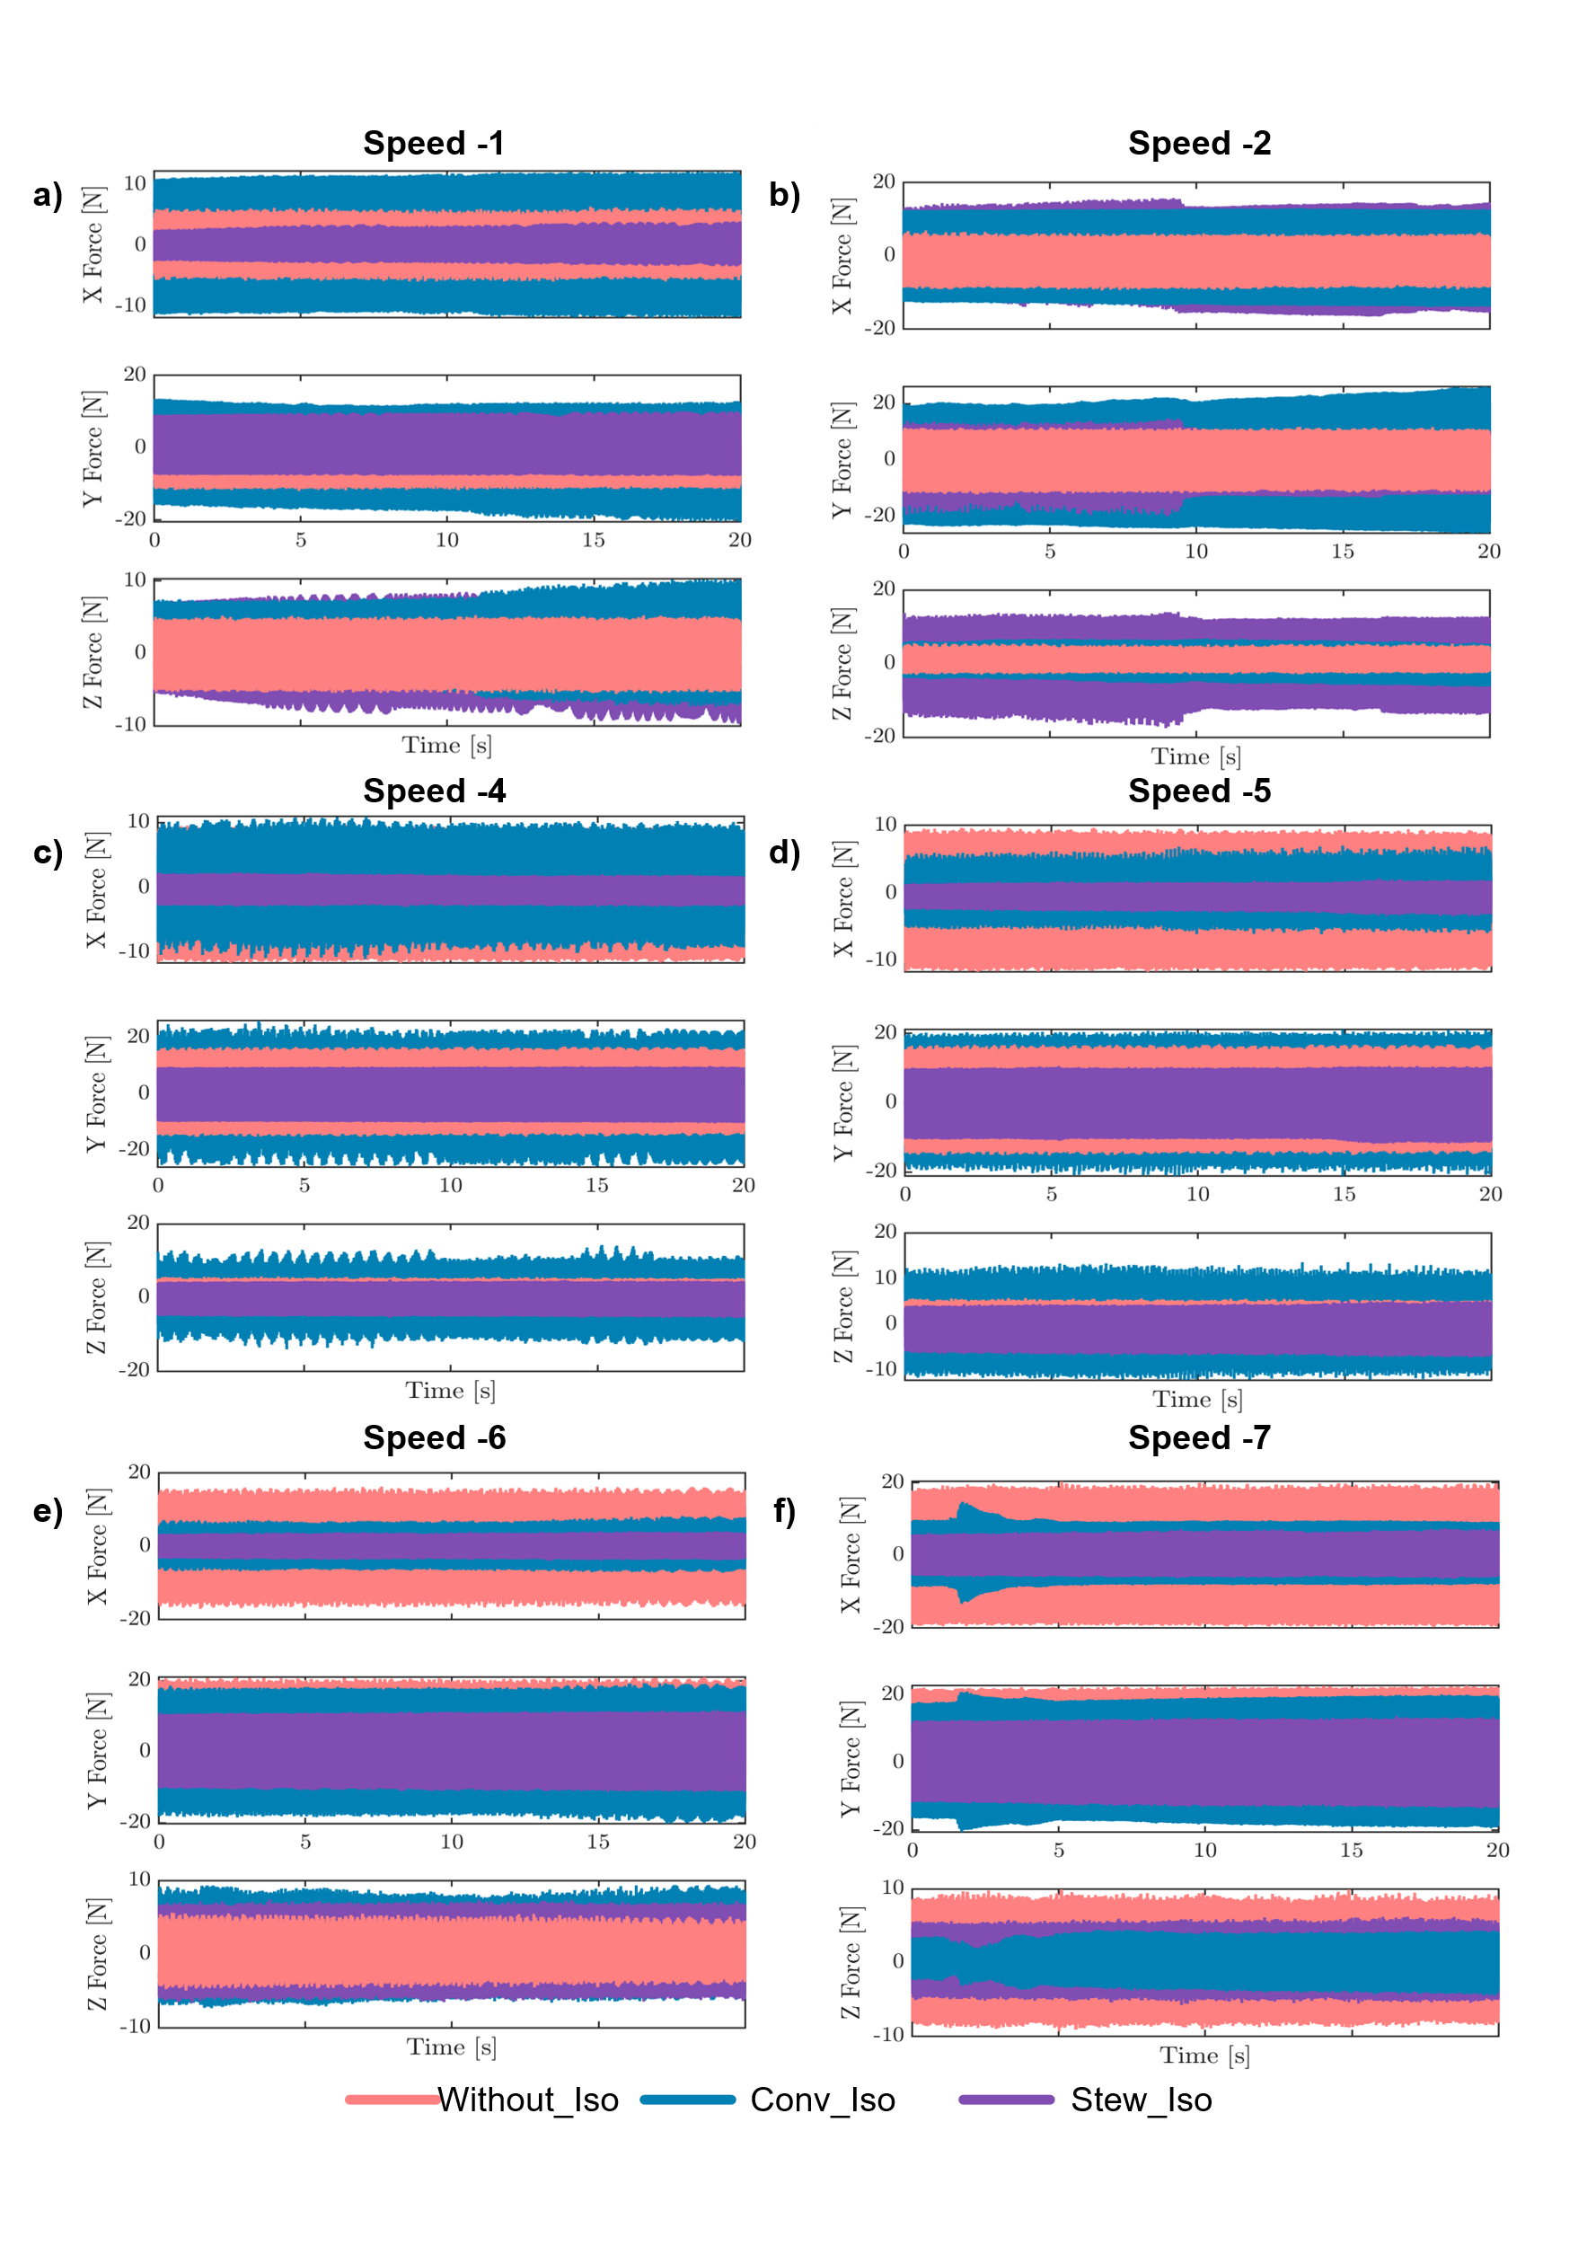
Results and Observations
At Low Tool Speeds

Slide 6
Results and Observations
At Medium Tool Speeds

Slide 7
Results and Observations
At High Tool Speeds

Slide 8
Results and Observations
Above force graphs Observations
At Low Speeds
At Medium Speeds
At High Speeds
With out isolator performance is best compared with isolator case.
Followed by Stewart platform isolator performance is the next best .
Notably at Speed 1 in transverse x-direction the magnitude of force is even lower than the normal case.
And conventional platform performance is poor compare to all because of its geometrical shape causing anisotropic condition with unequal force distribution.
Here onwards the isolators did show their attenuation of vibrations especially Stewart based isolator , tracing a path close to the reference force i.e., 0 N in our current experiment.
But when coming to the conventional isolator case having a similar performance as before with no signs of attenuation.
This is the most deserving and favourable speed domain where both of the isolator had a better attenuation characteristics.
Particularly conventional isolator is also displaying Amplification characteristics

Slide 9
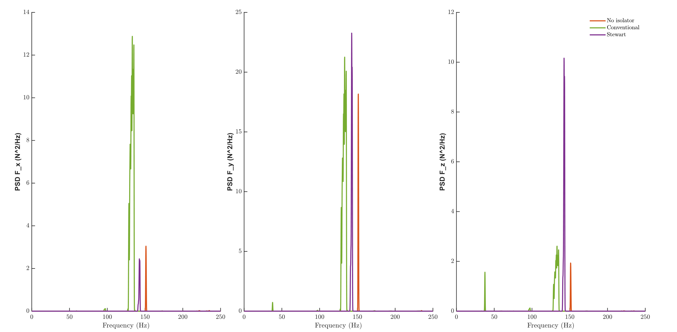
Results and Observations
Lower Speed 1 Power Spectral Density Graph

Slide 10
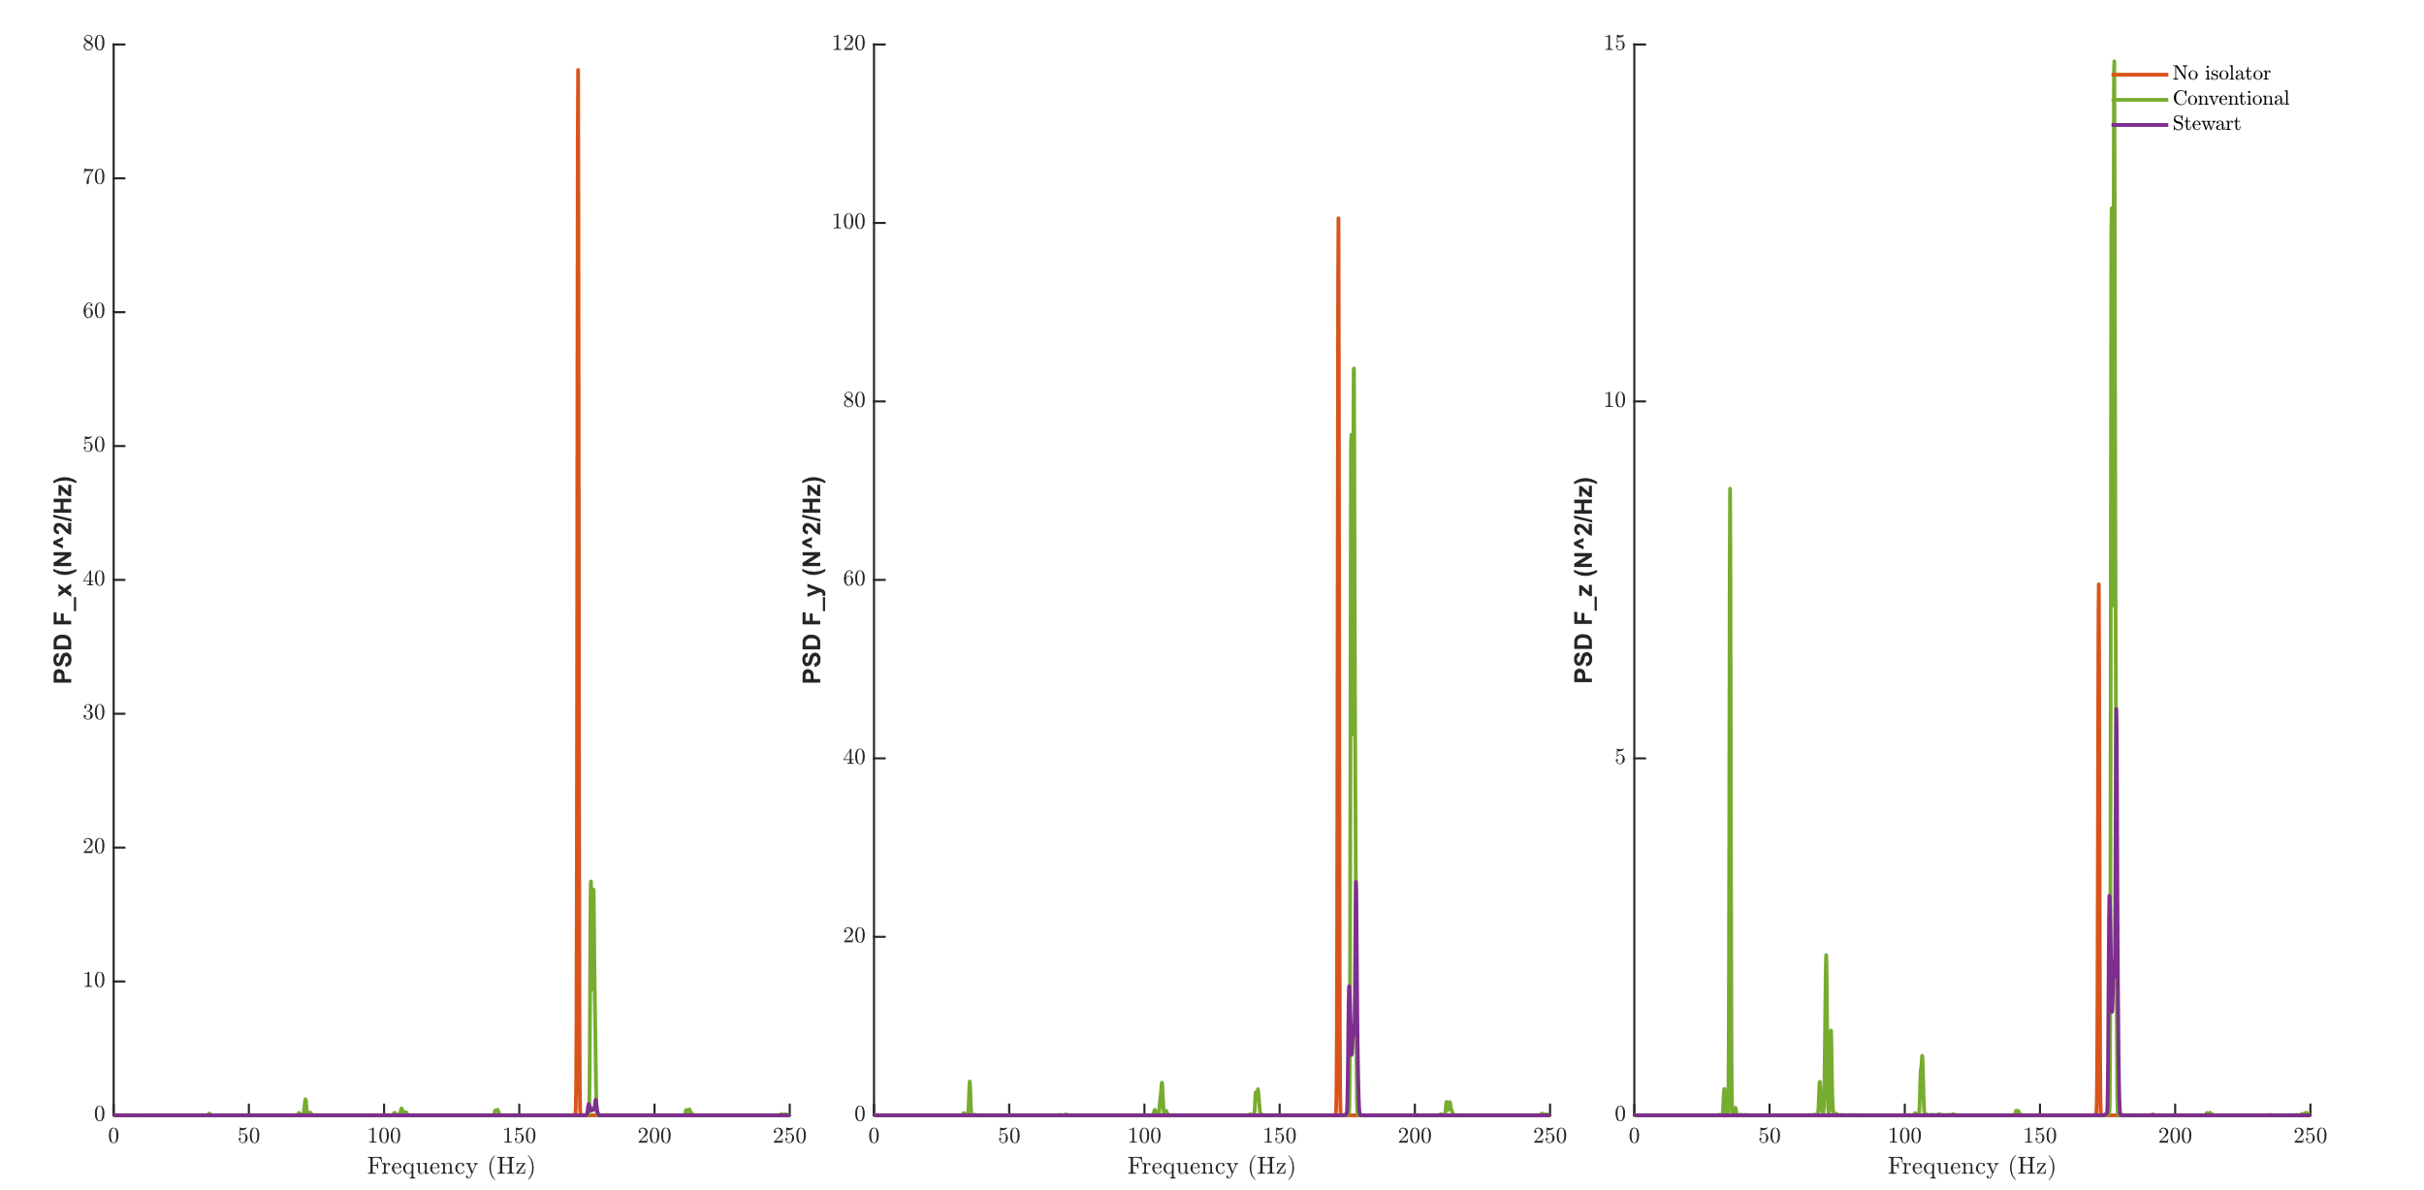
Results and Observations
Medium Speed 4 Power Spectral Density Graph

Slide 11
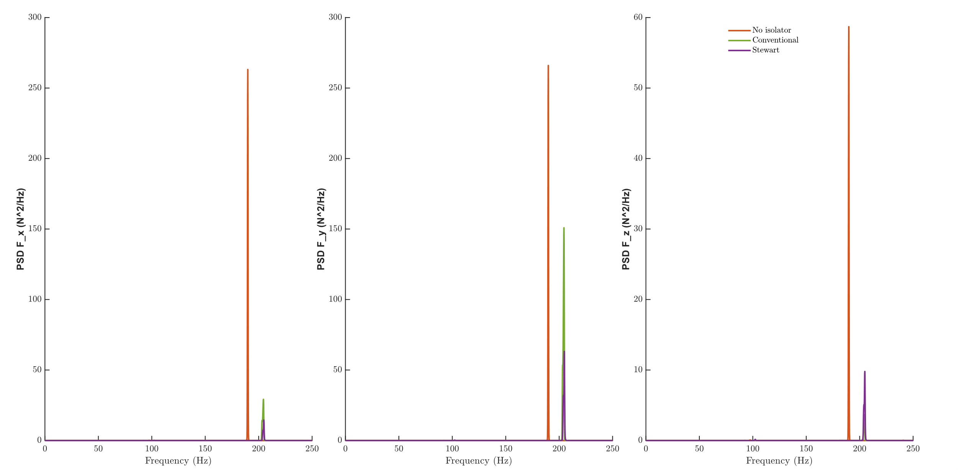
Results and Observations
Higher Speed 7 Power Spectral Density Graph

Slide 12
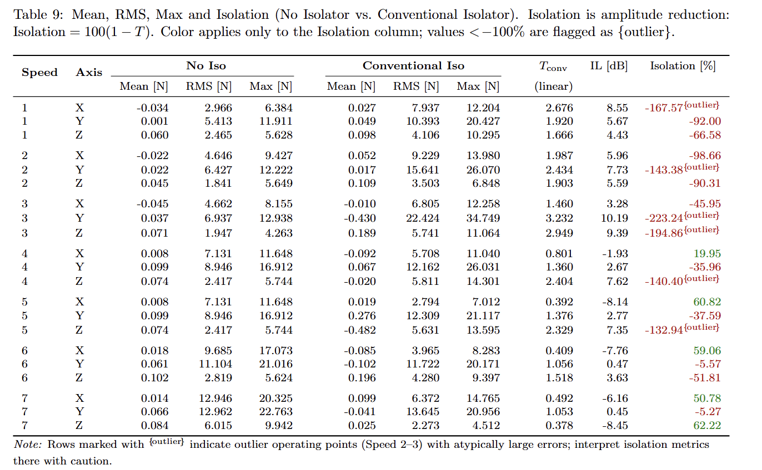
Results and Observations
No isolator vs Conventional Isolator – key Observations
Amplification at Low Speeds (1–3): Strong negative isolation values (−167%, −92%, −67%) → transmissibility ≫ 1, isolator in stiffness-controlled regime, amplifying instead of attenuating.
Outliers / Instabilities (Speeds 2–3): Extreme amplification in Y/Z (−223%, −194%) flagged as outliers → resonance crossings causing unstable force transmission.
Onset of Isolation (≥4): Isolation begins to appear, mainly in the X-axis, marking transition towards inertia-controlled behaviour.
Effective Isolation at Mid–High Speeds (5–6): X-axis shows ~60% isolation (≈ −8 dB), demonstrating mass-dominated inertia-controlled isolation.
Anisotropy at Highest Speed (7): Performance becomes axis-dependent: strong isolation in X (51%) and Z (62%), but poor along Y (−5%), highlighting design-geometry limitations.
Notes:
During “mass-dominated inertia-controlled isolation”, the characteristics are:
At higher tool speeds (Speeds 4–7 in your tables), the excitation frequency of the wheel exceeds the isolator’s natural frequency.
The isolator platform then operates in the isolation zone where the mass/inertia of the platform resists rapid input motion, leading to effective attenuation.
That’s why in your results, you observed up to 60% isolation (~−8 dB) in the X and Z directions at high speeds.

Slide 13
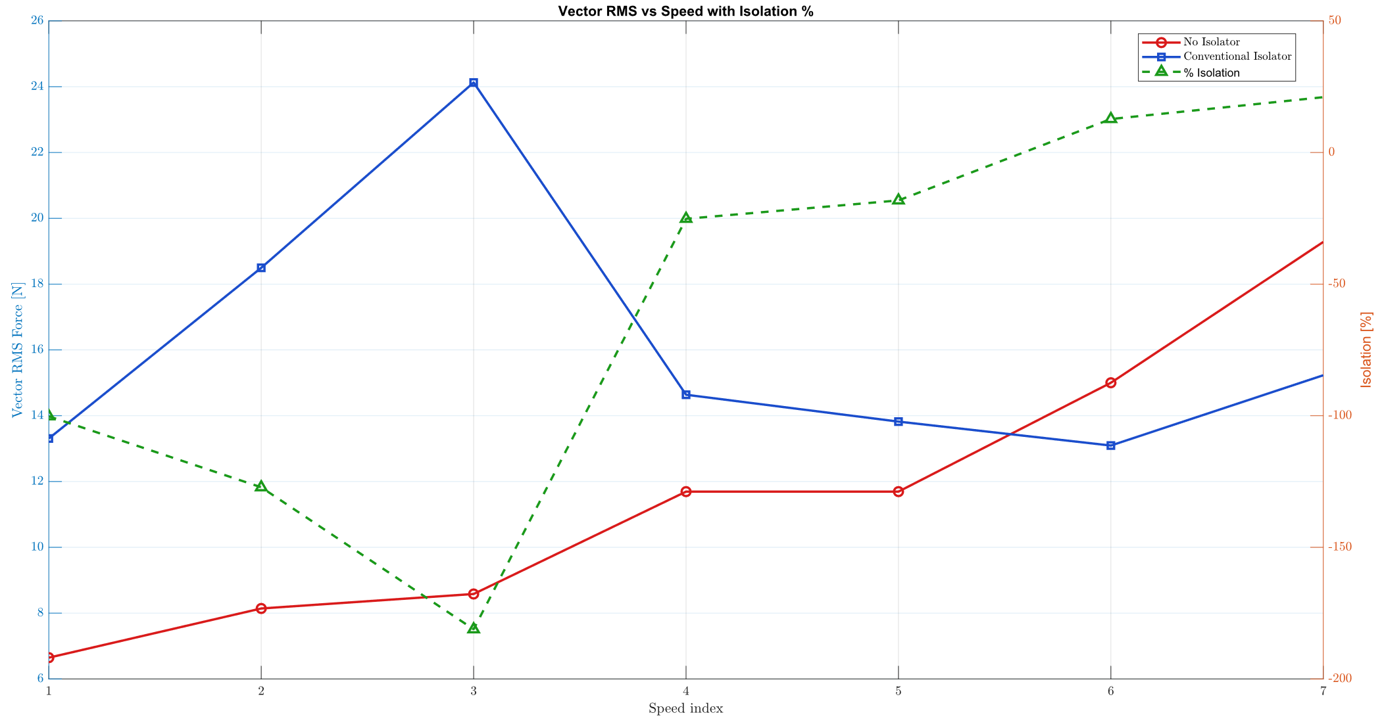
Results and Observations
Vector RMS Force vs Speed with Isolation % (Conventional Isolator)
Low speeds (1–3): Clear amplification — RMS forces increase and isolation % is strongly negative.
Mid speed (4): Onset of isolation, mainly in X-axis.
Higher speeds (5–6): Partial isolation appears (~60%), but performance is inconsistent across axes.

Slide 14
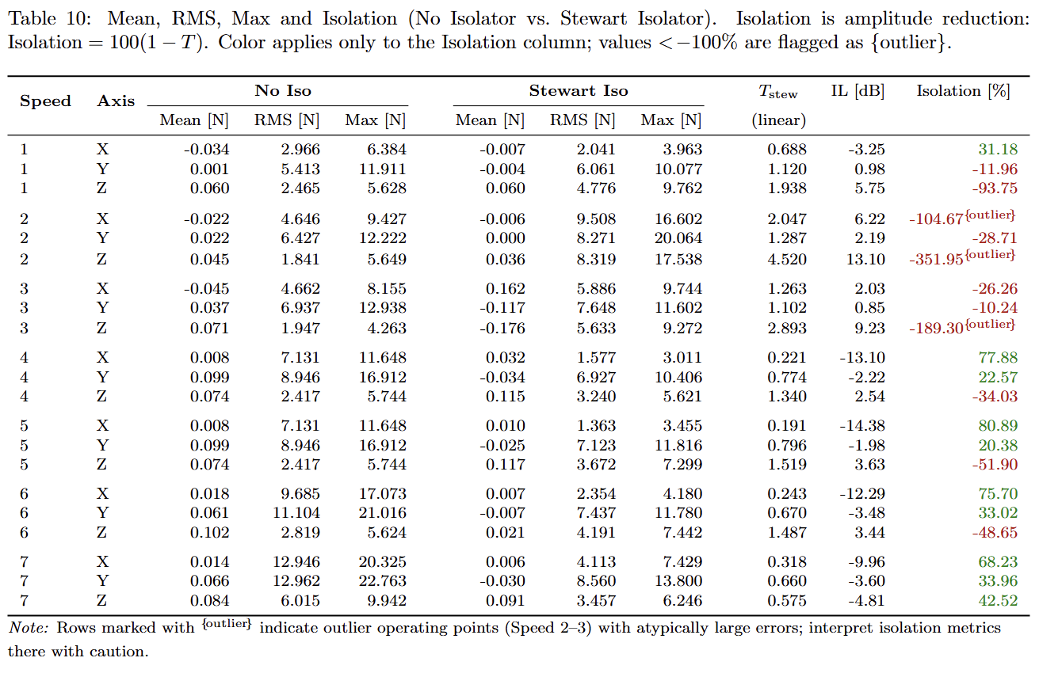
Results and Observations
No isolator vs Conventional Isolator – key Observations
Superior Low-Speed Stability: Unlike the conventional isolator, Stewart shows less severe amplification at low speeds; X and Y already provide partial attenuation at Speed 1, though Z still amplifies.
Reduced Outlier Severity: While an extreme outlier exists at Speed 2 (Z axis, −352%, 13 dB), outlier occurrences are fewer and less widespread compared to the conventional isolator, indicating better damping and stiffness integration.
Strong High-Speed Isolation: From Speed 4 onward, Stewart consistently achieves positive isolation; e.g., Speed 4 X-axis shows 77.9% (−13.1 dB), and Speed 5 X-axis peaks at 80.9% (−14.4 dB).
Multi-Axis Robustness: Provides more balanced attenuation across X, Y, Z at higher speeds; residual negative isolation in Y at Speeds 6–7 (−5.8%, −13.9%) is much milder than the conventional case.
Near-Isotropic Control: Stewart’s geometric configuration provides a more uniform stiffness distribution and balanced vibration suppression across X, Y, and Z, offering improved multi-directional performance.

Slide 15
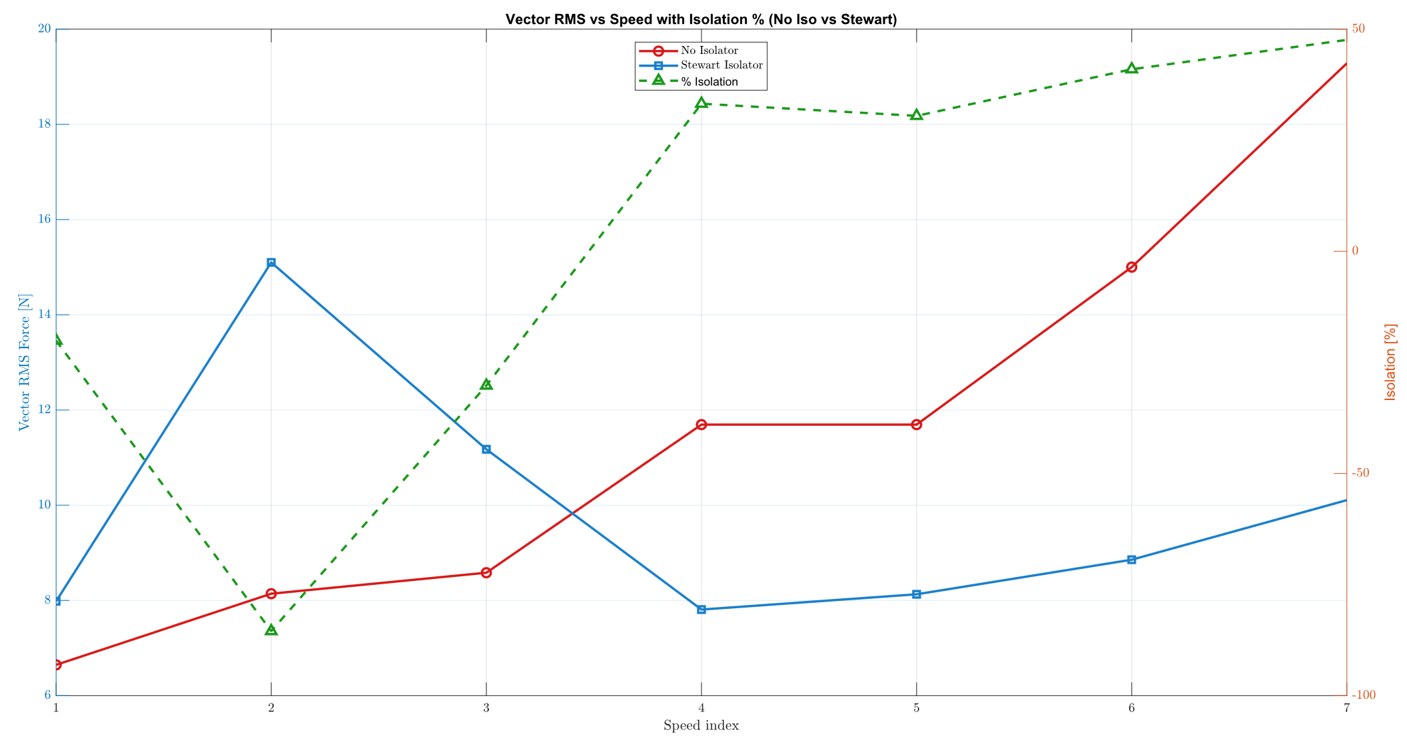
Results and Observations
Vector RMS Force vs Speed with Isolation % (Stewart Isolator)
Low speeds (1–3): Mixed results, some amplification (esp. Z), but less severe than conventional.
From speed 4 onward: Isolation becomes effective, especially in X.
Higher speeds (5–7): Consistent isolation across axes (up to ~80%), showing stable inertia-controlled behaviour.

Slide 16
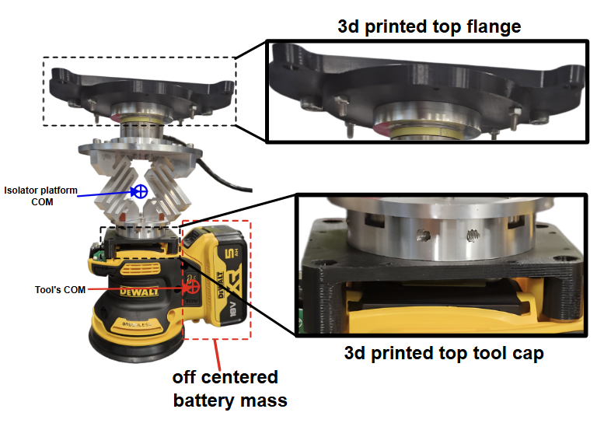
Results and Observations
Comparative Evaluation – Conventional vs Stewart Isolator
Aspect | Conventional Isolator | Stewart Isolator
Low-Speed Behavior (1–3) | Strong amplification (negative isolation, transmissibility ≫1); late onset of attenuation. | Amplifies at low speeds but less severe, with earlier onset of attenuation due to 6-DOF geometry.
Outlier Behavior | Frequent and severe amplification outliers (esp. Y/Z at speeds 2–3). | Outliers fewer and less severe; mainly limited to Z-axis at Speed 2.
Cause of Outliers | Flexible 3D-printed sandwich parts, COM misalignment with battery mass, and folded-beam design amplify coupling. | Better damping and stiffness integration reduce severity of outliers.
High-Speed Performance (≥4) | Mixed results: e.g., Speed 7 X-axis shows ~50% isolation (−6.2 dB) but Y simultaneously amplifies (−5%). | Consistent strong isolation (>60% across multiple axes at speeds 4–7).
Design Dependence | Unequal load sharing in folded beams → biased response to lateral forces. | More uniform stiffness distribution → balanced load handling.
Directional Dependence | Directionally biased; isolation varies significantly per axis. | Balanced attenuation across X, Y, Z; well-suited for multi-DOF robotic applications.
Overall Assessment | Limited isolation, prone to amplification and directional imbalance. | Superior stability, effective multi-axis control, and predictable high-frequency isolation.

Slide 17
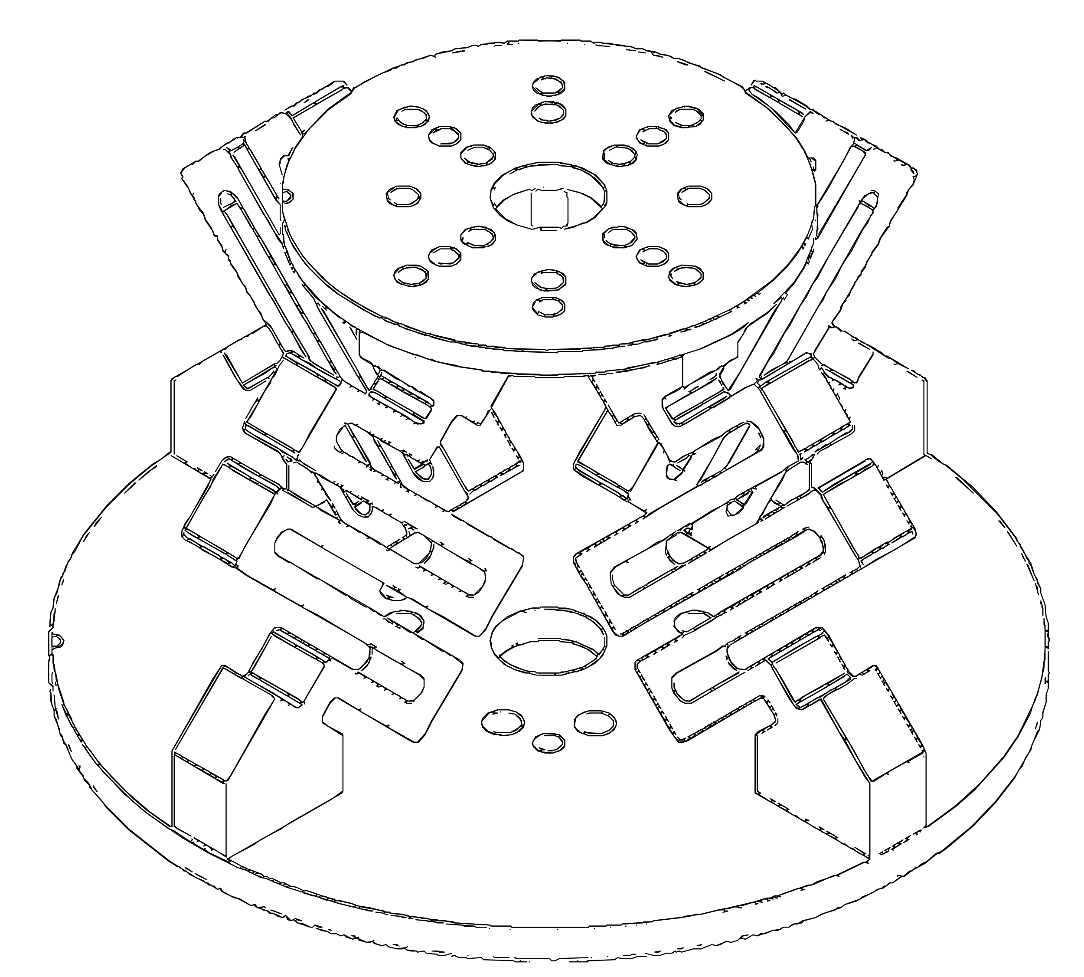
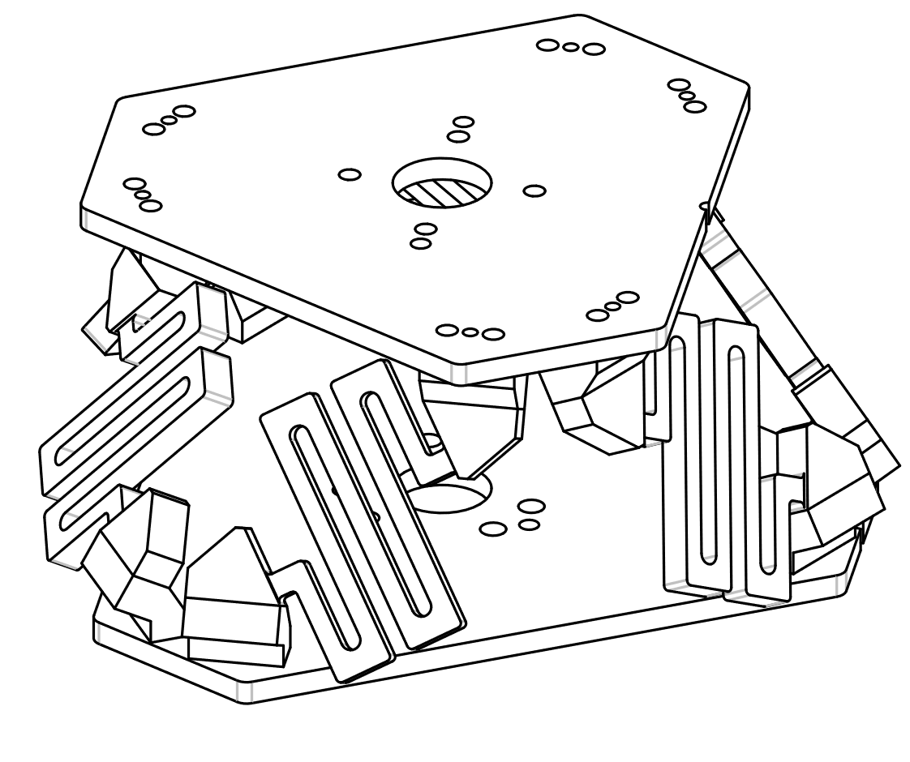
Final Experimental Summary
Performance Regime: Isolation effectiveness improves at higher tool speeds; Stewart shows stable, predictable attenuation across the operating band.
Stewart Advantages: Provides higher isolation percentages, balanced multi-axis control, compact design, and superior dynamic stability, making it more suitable as a passive end-effector interface.
Conventional Drawbacks: Exhibits resonance-driven amplification at low–mid frequencies and strong axis-dependent behavior, limiting robustness and applicability.
vs

Slide 18

Thank you very much for your attention...

